Slide 1
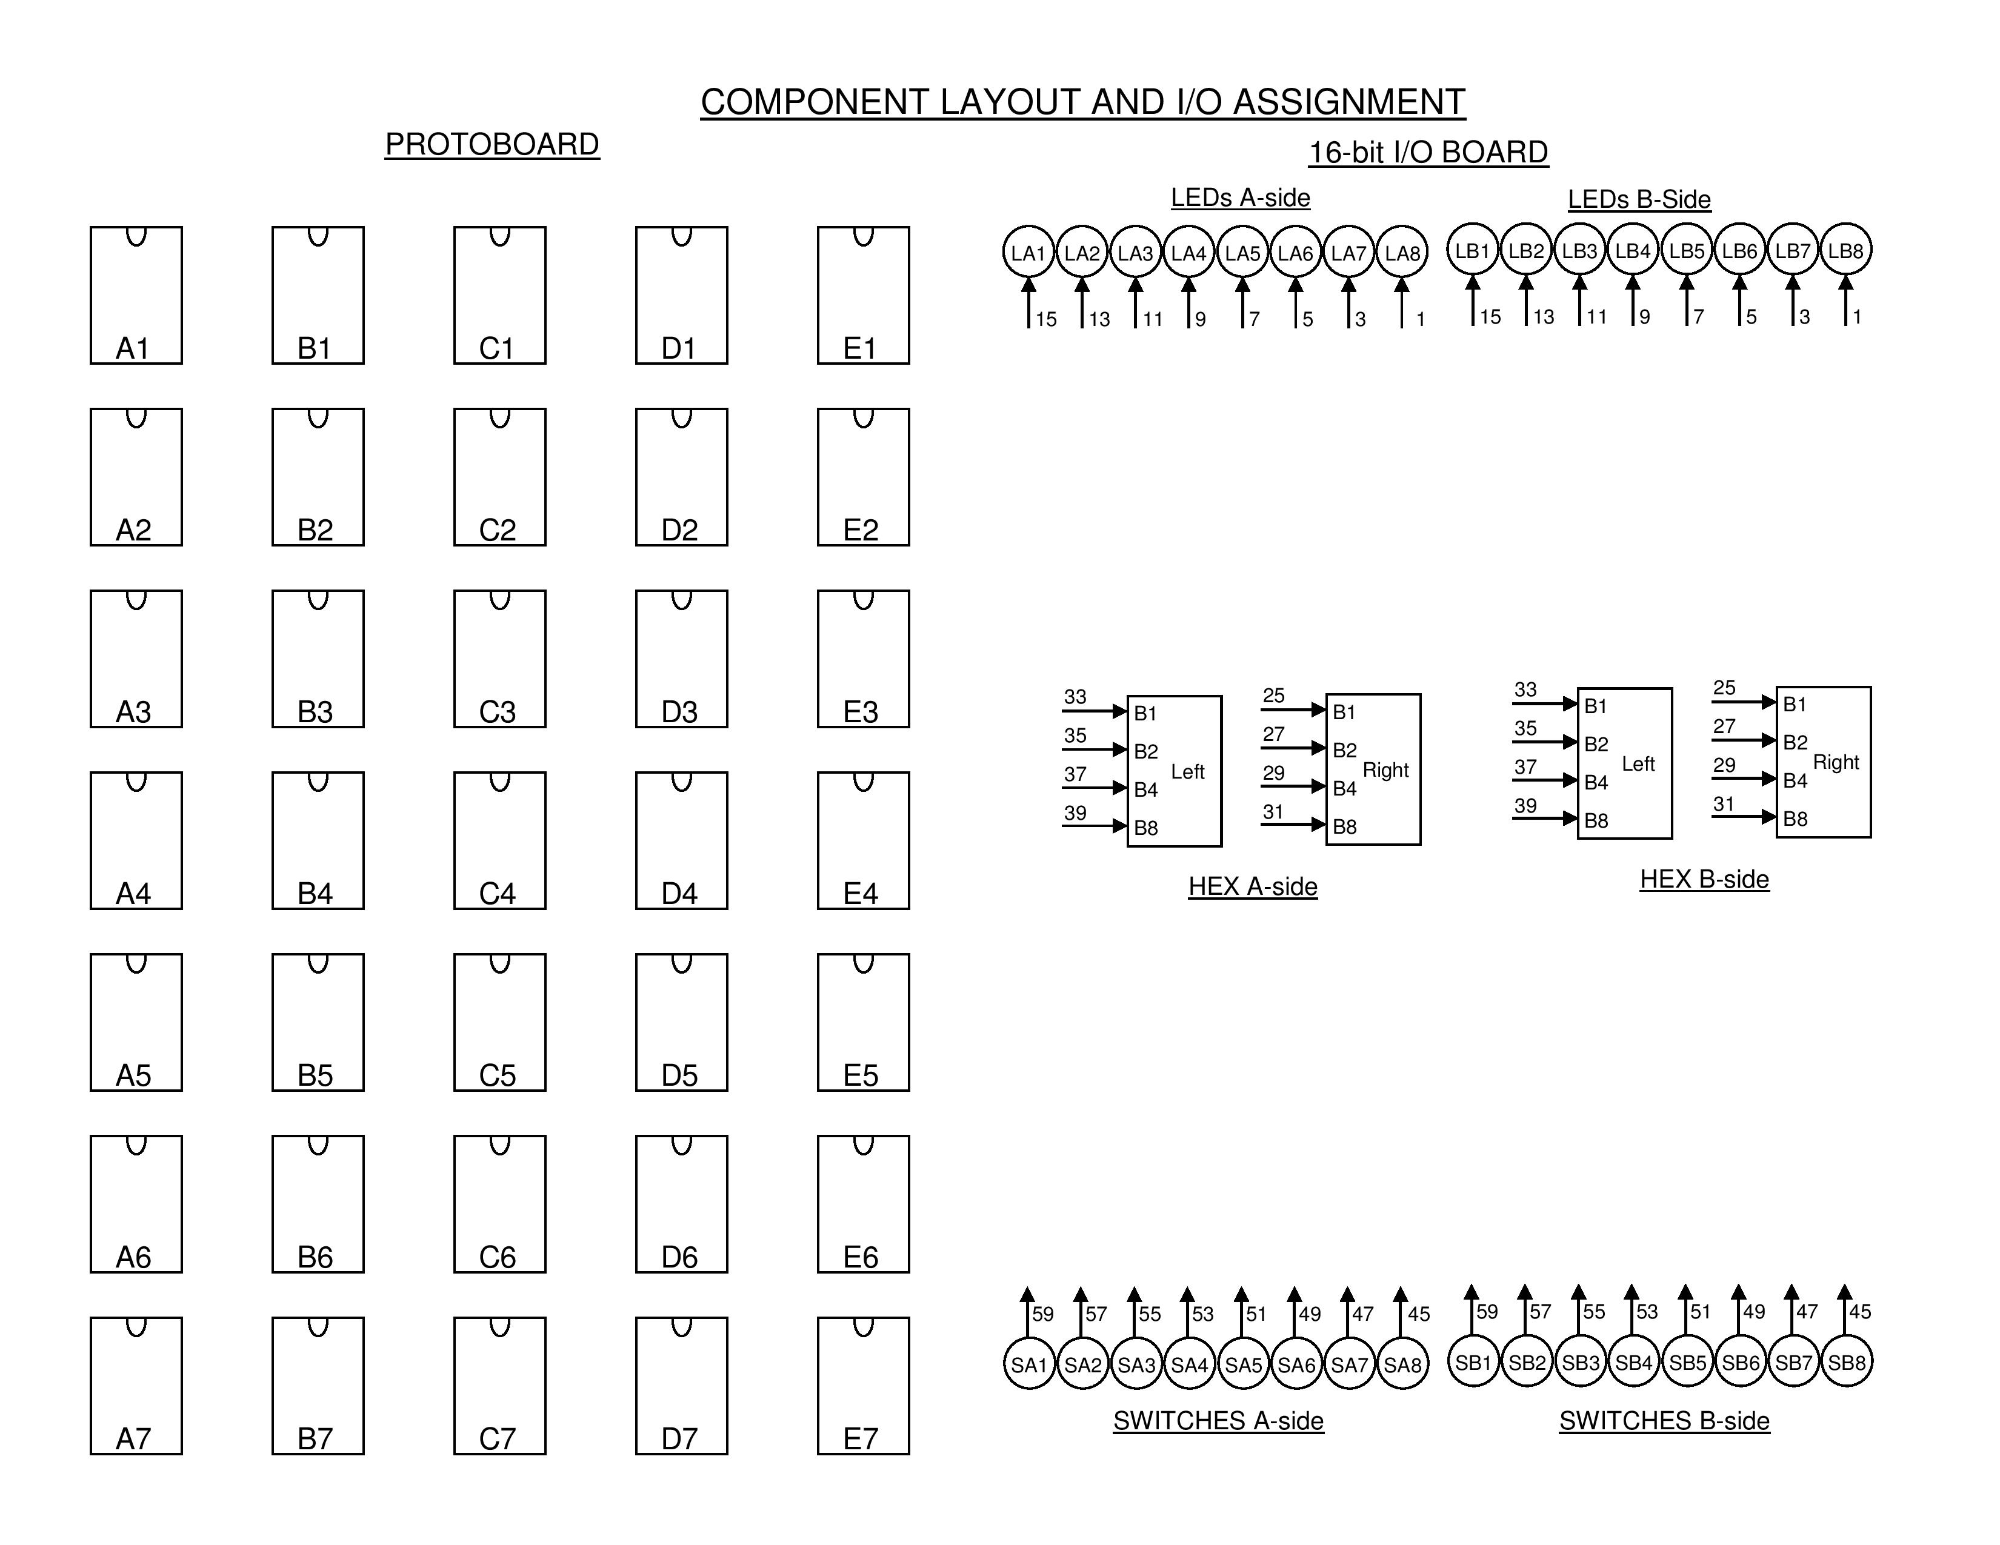
A
A
B
B
B
SN7400
Z
SN7400
B
B
B
C
C
Z’ Z A B C
A
SN7400
C
Z’
A B C

Slide 2
SN7400

